Slide 1


Thi Thanh Chương
14 June 2023

Slide 2

Outline
Executive Summary
Introduction
Methodology
Results
Conclusion
Appendix

Slide 3
Executive Summary
Summary of methodologies
Data Collection with API and Web Scraping
Data Wrangling
Exploratory Data Analysis with SQL and Data Visualization
Interactive Visual Analytics and Dashboards with Folium and Ploty Dash
Machine Learning Prediction
Summary of all results
Exploratory Data Analysis
Interactive Visual Analytics and Dashboards
Find the method performs best using test data

Slide 4
Introduction
Project background and context
SpaceX advertises Falcon 9 rocket launches on its website with a cost of 62 million dollars; other providers cost upward of 165 million dollars each, much of the savings is because SpaceX can reuse the first stage. Therefore, if we can determine if the first stage will land, we can determine the cost of a launch. This information can be used if an alternate company wants to bid against SpaceX for a rocket launch. We will also determine if SpaceX will reuse the first stage. Instead of using rocket science to determine if the first stage will land successfully, we will train a machine learning model and use public information to predict if SpaceX will reuse the first stage.
Problems you want to find answers
What factors affect landing results?
How does the relationship between each variable affect the outcome?
What are the necessary conditions to increase the probability of a successful landing?

Slide 5

Section 1

Slide 6
Methodology
Executive Summary
Data collection methodology:
Data was collected from SpaceX API and web scraping from Wikipedia
Perform data wrangling
The data was processed for categorical features by one-hot encoding.
Perform exploratory data analysis (EDA) using visualization and SQL
Perform interactive visual analytics using Folium and Plotly Dash
Perform predictive analysis using classification models
Build model Machine Learning include SVM, Classification Trees and Logistic Regression.
Use GridSearchCV for tune best Hyperparameter for model.
Evaluate classification by confusion matrix.

Slide 7
Data Collection
The dataset was collected by REST API and Web Scrapping from Wikipedia.
REST API : get request to the SpaceX API. Response is data in JSON format. Then, the JSON data was converted to a pandas dataframe using json_normalize() function.
SpaceX REST API
GET Requests
JSON Data
Pandas dataframe
Web Scrapping from Wikipedia: use the BeautifulSoup to extract the launch records as
HTML table. Then, the table was parsed and converted to a pandas dataframe.
Web scraping
BeautifulSoup
HTML table
Pandas dataframe

Slide 8
Data Collection – SpaceX API
SpaceX REST API
Filter the dataframe to only include `Falcon 9` launches
Data Cleaning
GET Requests
JSON Data
Pandas dataframe
Link Github:
AppliedDataScienceCapstone/jupyter-labs-spacex-data-collection-api.ipynb at main · thichuong/AppliedDataScienceCapstone · GitHub

Slide 9
Data Collection - Scraping
Link Github: AppliedDataScienceCapstone/jupyter-labs-webscraping.ipynb at main · thichuong/AppliedDataScienceCapstone · GitHub
Web scraping
BeautifulSoup
HTML table
Pandas dataframe
Create a data frame by parsing the launch HTML tables

Slide 10
Data Wrangling
Perform some Exploratory Data Analysis (EDA) to find patterns in the data and determine what would be the label for training supervised models.
Training Labels with `1` means it was successful. `0` means it was unsuccessful.
Identify and calculate the percentage of the missing values
Identify which columns are numerical and categorical
Calculate the number of launches on each site
Calculate the number and occurrence of each orbit
Calculate the number and occurrence of mission outcome of the orbits
Create a landing outcome label from Outcome column
Link Github: AppliedDataScienceCapstone/labs-jupyter-spacex-Data wrangling.ipynb at main · thichuong/AppliedDataScienceCapstone · GitHub

Slide 11
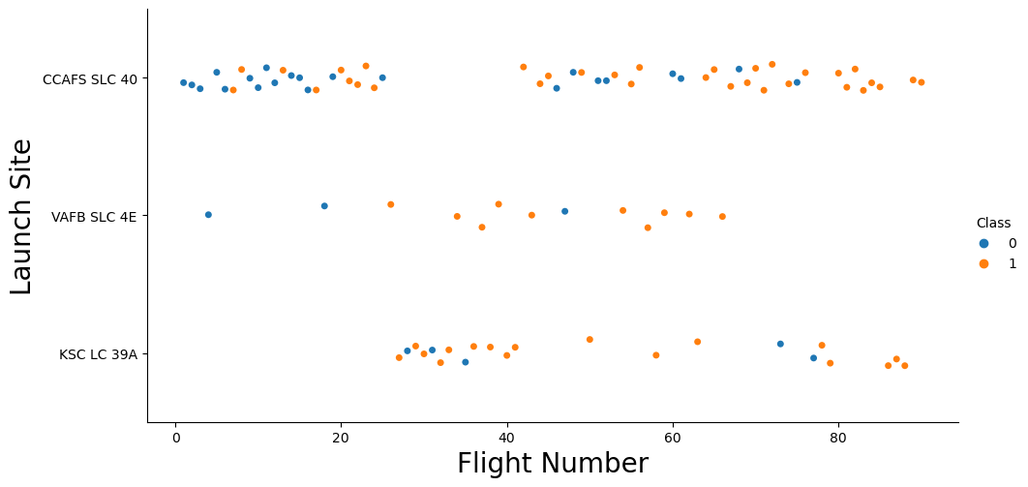
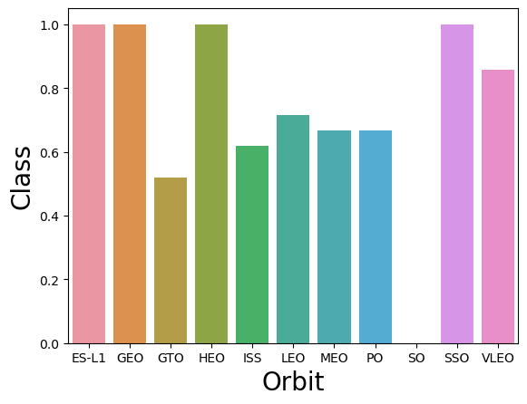
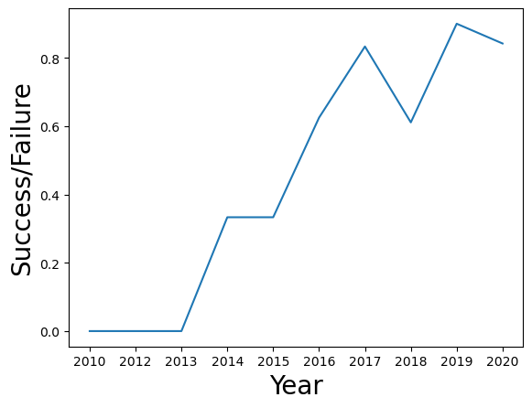
EDA with Data Visualization
Catplot: Visualize the relationship
Between Payload and Flight Number.
Between Flight Number and Launch Site.
Between Payload and Launch Site.
Between Flight Number and Orbit Type.
Between Payload and Orbit Type.
Barplot: Visualize the relationship between success rate of each orbit type
Line chart: Visualize the launch success yearly trend
Link Github: AppliedDataScienceCapstone/jupyter-labs-eda-dataviz.ipynb at main · thichuong/AppliedDataScienceCapstone · GitHub

Slide 12
EDA with SQL
the SQL queries performed
Display the names of the unique launch sites in the space mission
SELECT DISTINCT "Launch_Site" FROM SPACEXTBL
Display 5 records where launch sites begin with the string 'CCA’
SELECT * FROM SPACEXTBL where "Launch_Site" like "CCA%" LIMIT 5
Display the total payload mass carried by boosters launched by NASA (CRS)
SELECT SUM("PAYLOAD_MASS__KG_") FROM SPACEXTBL where "Customer" like "NASA (CRS)“
Display average payload mass carried by booster version F9 v1.1
SELECT AVG("PAYLOAD_MASS__KG_") FROM SPACEXTBL where "Booster_Version" like "F9 v1.1“
List the date when the first succesful landing outcome in ground pad was achieved
SELECT MIN(Date) FROM SPACEXTBL where Landing_Outcome = "Success (ground pad)"
List the names of the boosters which have success in drone ship and have payload mass greater than 4000 but less than 6000
SELECT "Booster_Version", "PAYLOAD_MASS__KG_" FROM SPACEXTBL WHERE ("PAYLOAD_MASS__KG_" BETWEEN 4000 AND 6000) AND "Landing_Outcome" = "Success (drone ship)"
Link Github: AppliedDataScienceCapstone/jupyter-labs-eda-sql-coursera_sqllite.ipynb at main · thichuong/AppliedDataScienceCapstone · GitHub

Slide 13
EDA with SQL
the SQL queries performed
List the total number of successful and failure mission outcomes.
SELECT Mission_Outcome, Count(*) FROM SPACEXTBL GROUP BY Mission_Outcome
Listing the names of the booster_versions which have carried the maximum payload mass.
SELECT DISTINCT Booster_Version FROM SPACEXTBL WHERE PAYLOAD_MASS__KG_ = (SELECT MAX(PAYLOAD_MASS__KG_) FROM SPACEXTBL)
List the records which will display the month names, failure landing_outcomes in drone ship ,booster versions, launch_site for the months in year 2015..
SELECT substr(Date, 4, 2) AS Month, Landing_Outcome, Booster_Version, Launch_Site FROM SPACEXTBL WHERE substr(Date,7,4)='2015' AND Landing_Outcome = 'Failure (drone ship)'
Rank the count of successful landing_outcomes between the date 04-06-2010 and 20-03-2017 in descending order.
SELECT Landing_Outcome, COUNT(Landing_Outcome) as Total FROM SPACEXTBL WHERE (Date BETWEEN '04/06/2010' AND '20/03/2017’) AND Landing_Outcome LIKE 'Success%’ GROUP BY Landing_Outcome ORDER BY Total DESC
Link Github: AppliedDataScienceCapstone/jupyter-labs-eda-sql-coursera_sqllite.ipynb at main · thichuong/AppliedDataScienceCapstone · GitHub

Slide 14
Build an Interactive Map with Folium
Summarize what map objects:
folium.Circle to add a highlighted circle area with a text label on a specific coordinate
folium.Marker to add a highlighted circle area with a text label on a specific coordinate for each launch site on the site map
MarkerCluster to simplify a map containing many markers having the same coordinate.
MousePosition to get coordinate for a mouse over a point on the map
Folium.PolyLine to draw a PolyLine between a launch site to the selected coastline point
Link Github: AppliedDataScienceCapstone/lab_jupyter_launch_site_location.ipynb at main · thichuong/AppliedDataScienceCapstone · GitHub

Slide 15
Build a Dashboard with Plotly Dash
This dashboard application contains input components such as a dropdown list and a range slider to
interact with a pie chart and a scatter point chart.
Dropdown list to enable Launch Site selection
Slider to select payload range
Plotted pie charts: showing the total launches by a certain sites
Plotted scatter graph: showing the relationship with Outcome and Payload Mass (Kg) for the different booster version.
Link Github: AppliedDataScienceCapstone/spacex_dash_app.py at main · thichuong/AppliedDataScienceCapstone · GitHub

Slide 16
Predictive Analysis (Classification)
Summarize of the model developments:
Load the dataframe
Standardize the data
Split into training and test datasets
Created a machine learning models
Using GridSearchCV, found the best machine learning method for predictions.
Founding the classification model that performs best using test data
Link Github: AppliedDataScienceCapstone/SpaceX_Machine_Learning_Prediction_Part_5.jupyterlite.ipynb at main · thichuong/AppliedDataScienceCapstone · GitHub

Slide 17
Predictive Analysis (Classification)
Load the dataframe
Standardize the data
Split into training and test datasets
Created a machine learning models and Using GridSearchCV
Calculate the accuracy, plot confusion matrix on the test data
Founding the classification model that performs best using test data
Creation of variable Y from the column “Class”
Best parameters
Link Github: AppliedDataScienceCapstone/SpaceX_Machine_Learning_Prediction_Part_5.jupyterlite.ipynb at main · thichuong/AppliedDataScienceCapstone · GitHub

Slide 18
Results
Exploratory data analysis results
Interactive analytics demo in screenshots
Predictive analysis results

Slide 19

Section 2

Slide 20
Flight Number vs. Launch Site
This scatter plot shows that there were more successful landings as the flight numbers increased.

Slide 21
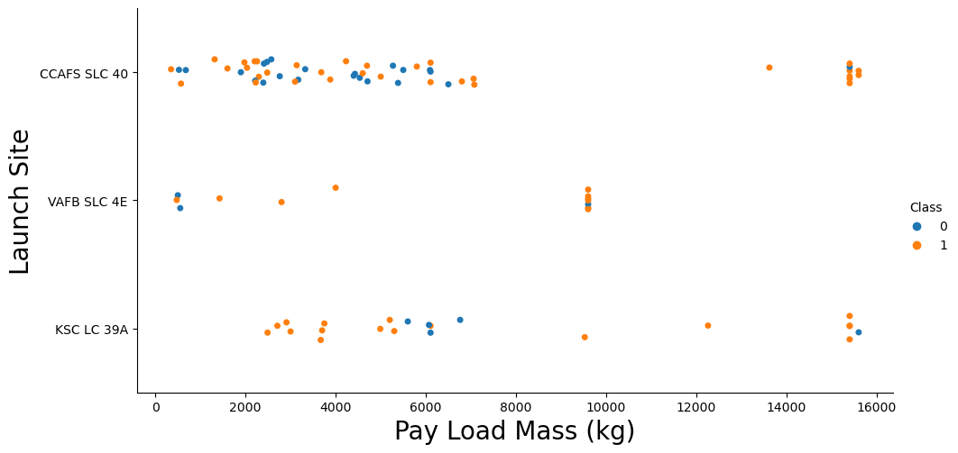
Payload vs. Launch Site
The probability of the success rate will be highly increased when Payload Mass increased .
the VAFB-SLC launch site there are no rockets launched for heavy payload mass(greater than 10000).

Slide 22
Success Rate vs. Orbit Type
Some orbits has 100% success rate such as SSO, HEO, GEO AND ES-L1 while SO orbit produced 0% rate of success.

Slide 23
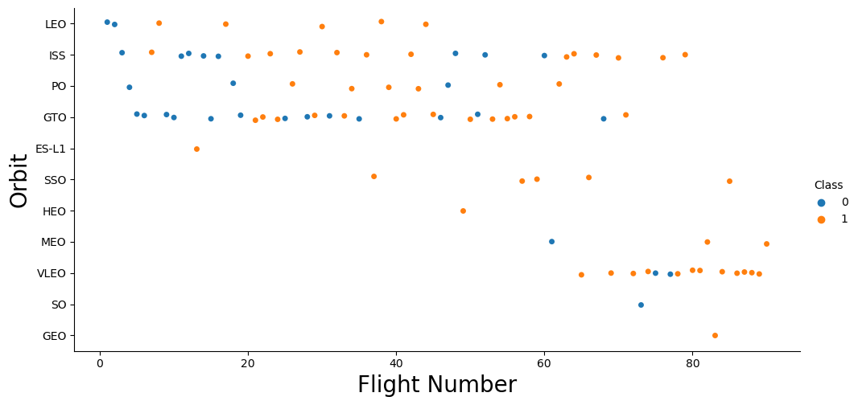
Flight Number vs. Orbit Type
the Success rate related to the number of flights for each orbit

Slide 24
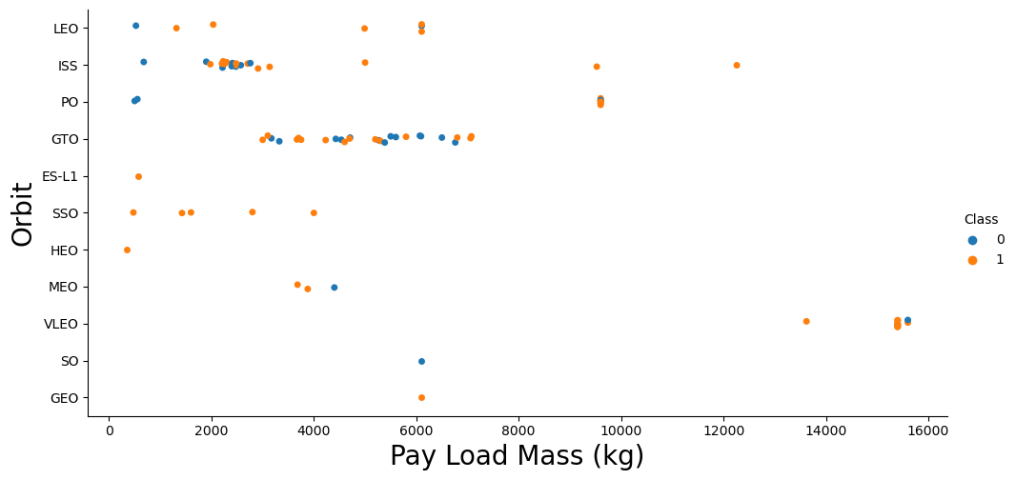
Payload vs. Orbit Type
With heavy payloads, the successful landing are more for PO, LEO and ISS orbits.

Slide 25
Launch Success Yearly Trend
the success rate has increased from 2013 to 2020.

Slide 26
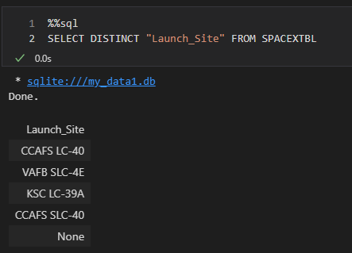
All Launch Site Names
used the DISTINCT statement to find only unique launch sites from the SpaceX data.

Slide 27
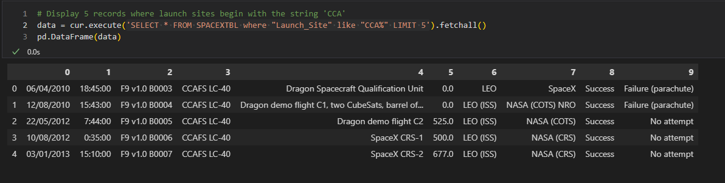
Launch Site Names Begin with 'CCA'
We used the query to display 5 records where launch sites begin with `CCA`

Slide 28
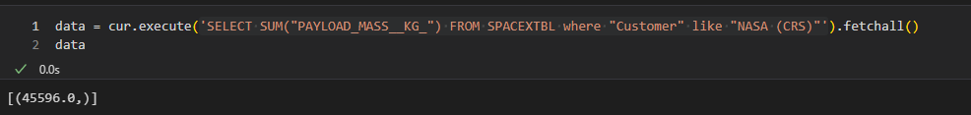
Total Payload Mass
the total payload carried by boosters from NASA using SUM function as 45596

Slide 29
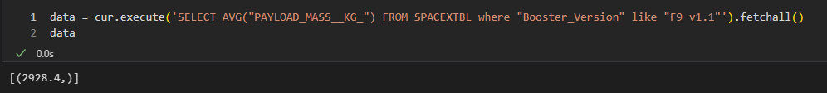
Average Payload Mass by F9 v1.1
The average payload mass carried by F9 v1.1 was 2928.4 kg

Slide 30
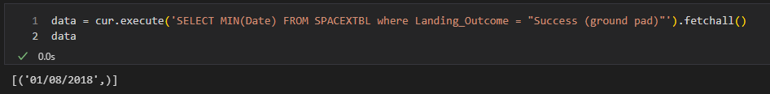
First Successful Ground Landing Date
The first successful landing outcome on ground pad was 1st August 2018.

Slide 31
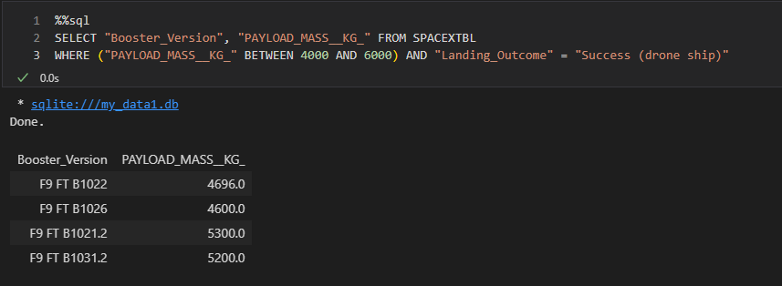
Successful Drone Ship Landing with Payload between 4000 and 6000
Using the WHERE clause and the AND operater.

Slide 32
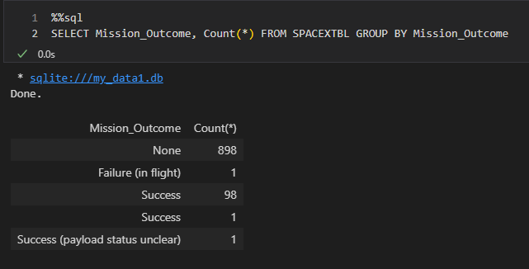
Total Number of Successful and Failure Mission Outcomes
Using COUNT function and GROUP BY statement.

Slide 33
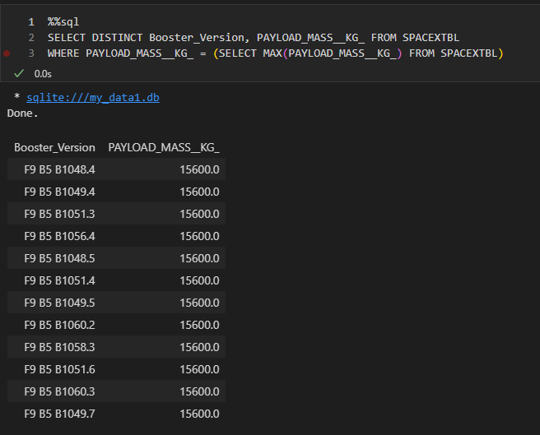
Boosters Carried Maximum Payload
using a subquery in the WHERE clause and the MAX() function.

Slide 34
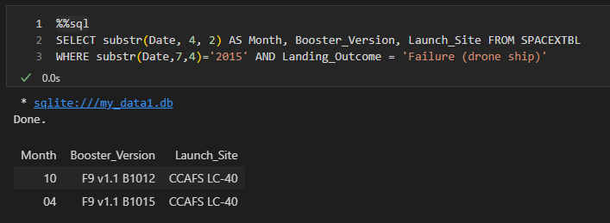
2015 Launch Records
List the records which will display the month names, failure landing_outcomes in drone ship ,booster versions, launch_site for the months in year 2015.
Using WHERE clause, AND, and “substr”.

Slide 35
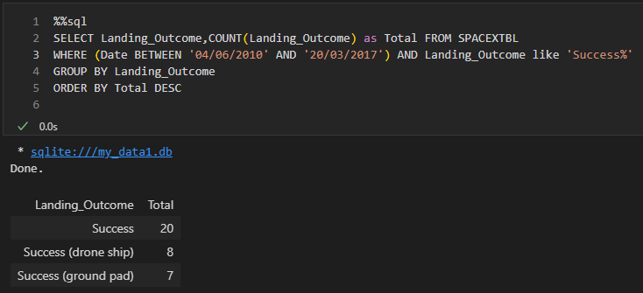
Rank Landing Outcomes Between 2010-06-04 and 2017-03-20
Rank the count of successful landing_outcomes between the date 04-06-2010 and 20-03-2017 in descending order.
Using COUNT, WHERE, BETWEEN, AND, GROUP BY, ORDER BY

Slide 36

Section 3

Slide 37
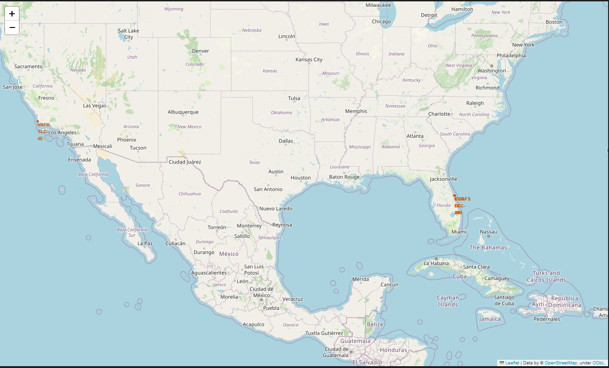
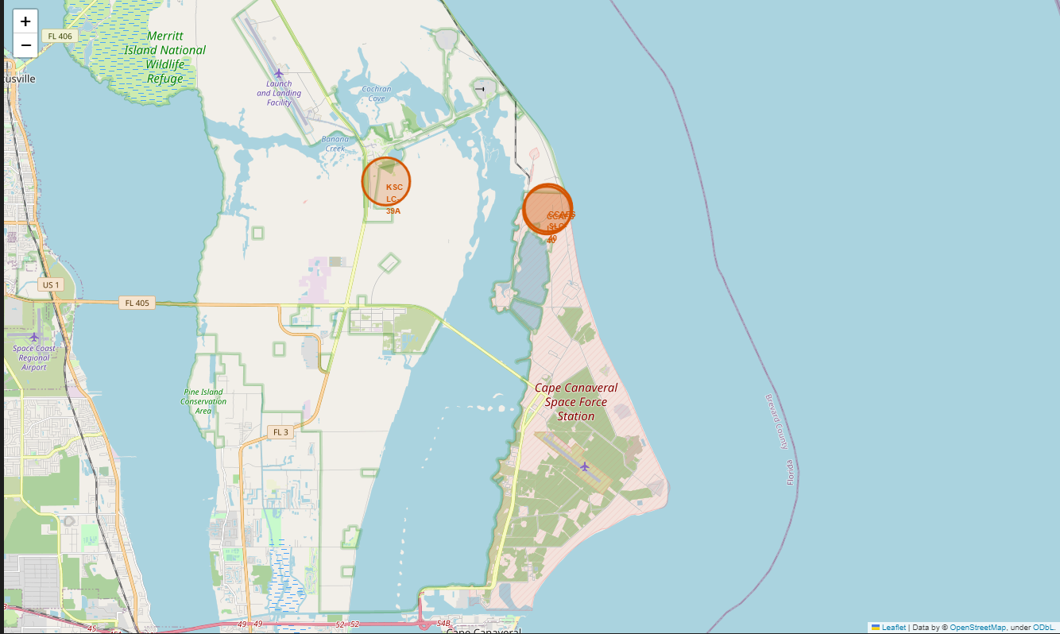
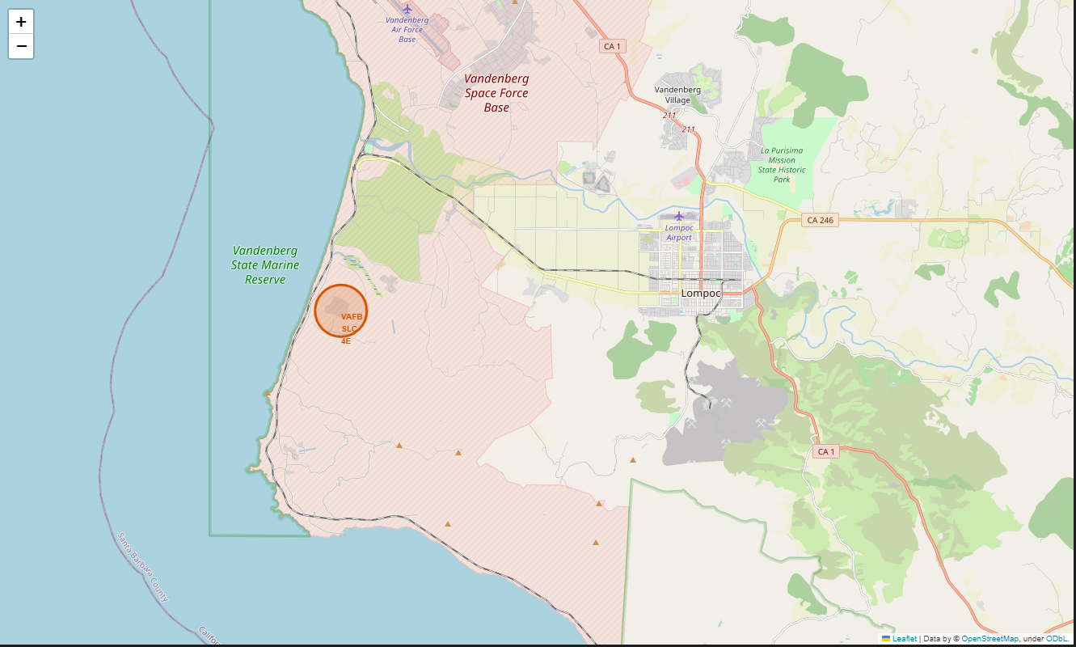
All launch sites locations
We can see that all the SpaceX launch sites

Slide 38
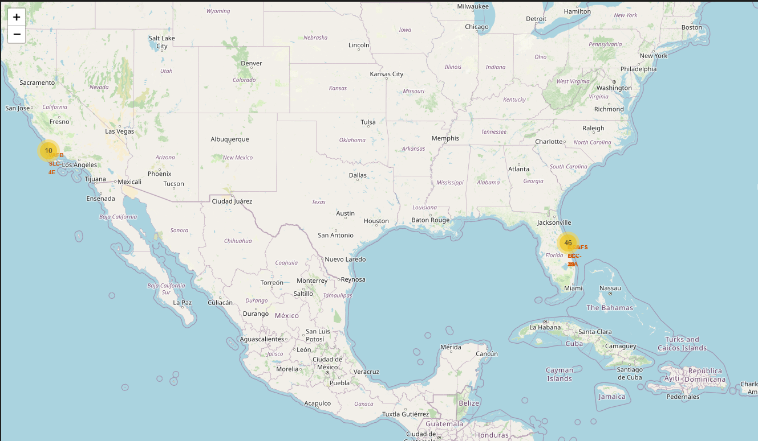
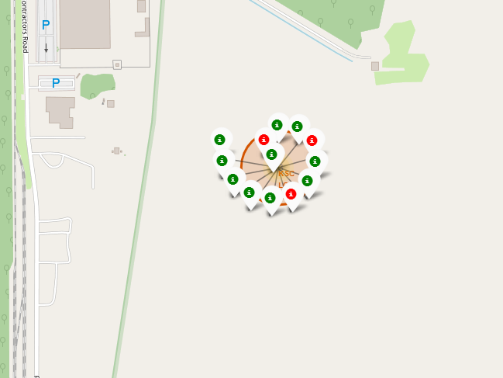
the success/failed launches for each site
shows a green marker if a launch was successful, and a red marker if a launch was failed.

Slide 39
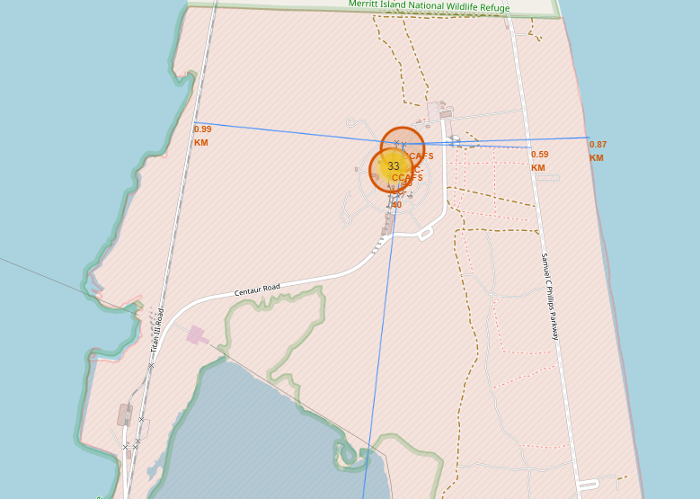
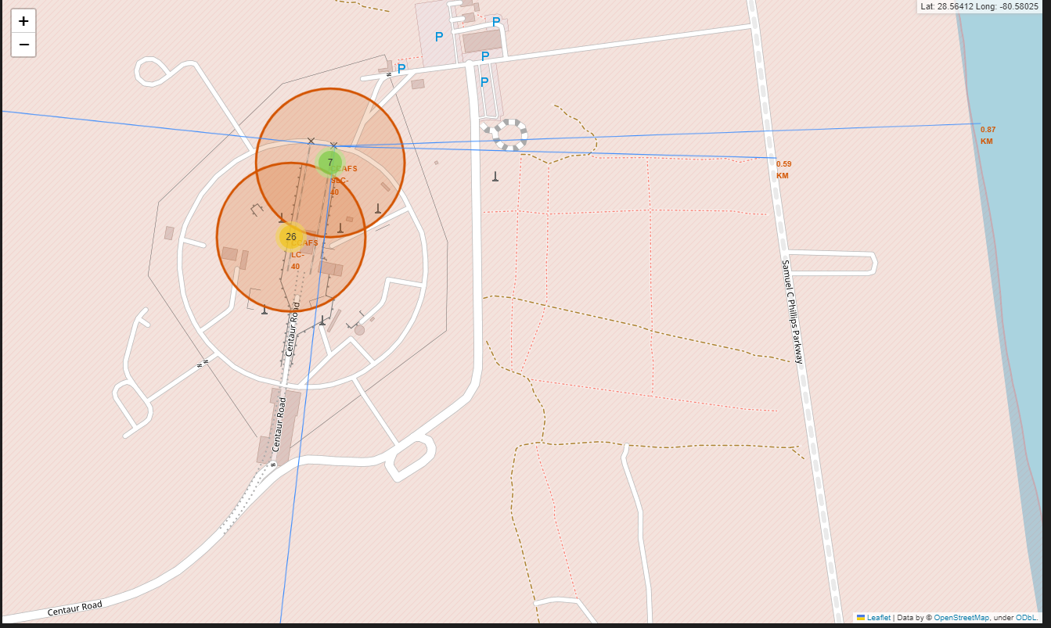
Launch site to its proximities
Draw a line between a launch site to its closest city, railway, highway

Slide 40

Section 4

Slide 41
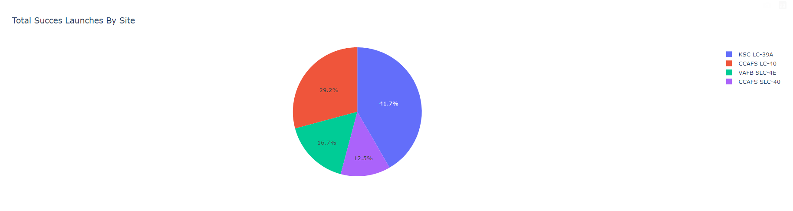
Total Successful Launches By Site
The KSC LC-39A has the highest total launch success from all the site

Slide 42
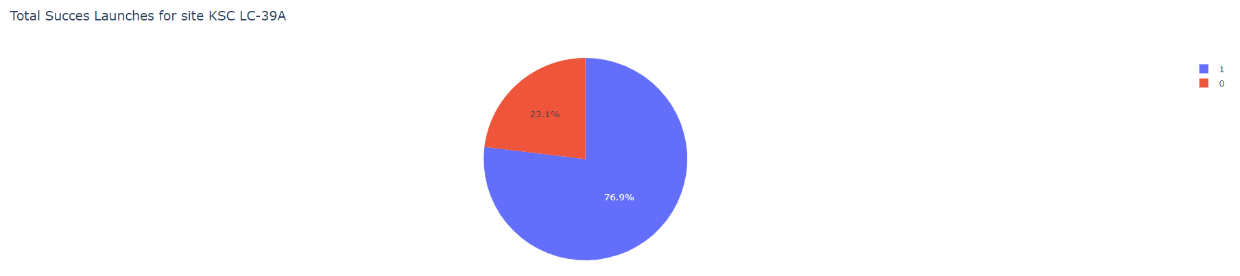
Highest launch success ratio
76.9% of the total launches at site KSC LC-39A were successful

Slide 43
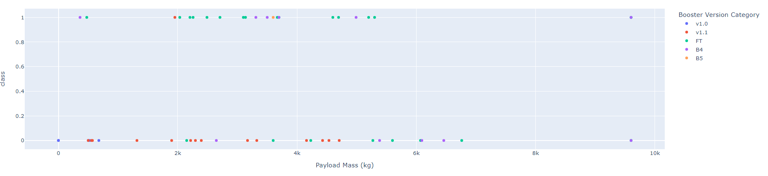
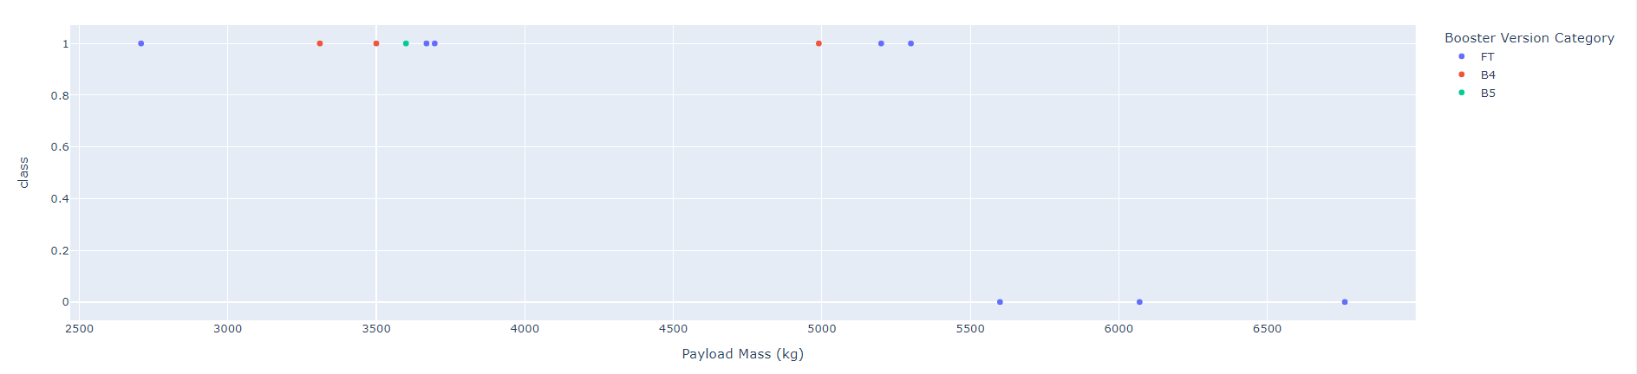
Payload vs. Launch Outcome scatter plot for all sites
the success rate for low weighted payload is higher than heavy weighted payload

Slide 44

Section 5

Slide 45
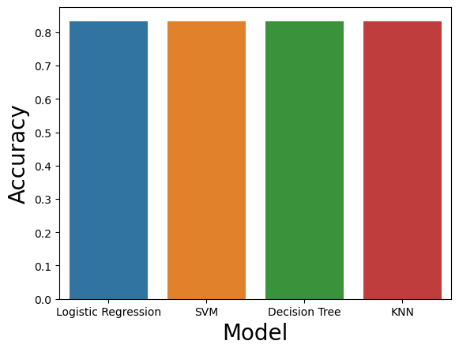
Classification Accuracy
All the models have an accuracy score of 83.33% using test data.

Slide 46
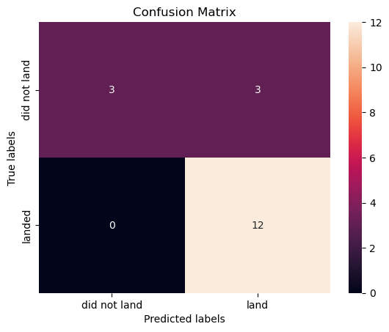
Confusion Matrix
All models have identical Confusion Matrix
Have 3 False Positive.

Slide 47
Conclusions
All Machine Learning Algorithm have the same accuracy score.
The KSC LC-39A has the highest total launch success from all the site
the success rate has increased from 2013 to 2020.
the Success rate related to the number of flights for each orbit.

Slide 48
Appendix
For Python code snippets, SQL queries, charts, Notebook outputs, and data sets, follow this GitHub link:
thichuong/AppliedDataScienceCapstone (github.com)

Slide 49


